Slide 1
PSC Interns 2018 Final Report Presentation: Building a Data Pipeline for Calima Dashboard
Date: 2018/08/04
Intern: Alice (Chia-Hua Lee)

Slide 2
Agenda
Motivation
Data Source
Data Pipeline
Data Preprocessing
Dashboard Demo
Benefit for the Center

Slide 3

1. Motivation
…
Deliver
the right data
to the
right person
System Administrator
Consultants
Director
End Users

Slide 4
2. Data Source

Slide 5
Data Source: Allocations
About Allocations Database
Development Environment: bell
Production Environment: noll
Data History: 2016 /03 ~ 2018/8/4
Data Size: 8883,000+ rows
# | Table Name | Brief Description
1 | public.subgrant | grant info
2 | Public. subgrantplatinfo | platform info: Reg, GPU, Large,SU allocations
3 | public.subgrantmach | machine Reg, GPU, Large
4 | platmachuser | grant/platform/machine/username
5 | users | grant/platform/machine/username
6 | nsfaffiliations | affiliations table (eg. CMU, Pitt, MIT, etc..)
7 | public.jobs | subset of slurmdb focusing on jobs for accounting purposes
8 | public.prorated_jobs | Truncate jobs into daily basis
9 | Public.actions | new grant, renewal, supplement, time_extension, SU amount

Slide 6
Data Source: Allocations
users | platmachuser | subgrant | subgrantmach | nsfaffiliations | jobs | prorated_jobs
pscid | subgrantnumber | subgrantnumber | chargeid | affilcode | job_id | job_id
firstname | machine | pipscid | machine | affiliation | machine | username
lastname | username | consultant | startdate | lat | walltime | machine
department |  | title | enddate | long | charge_id | charge_id
affilcode |  |  | allocation |  | partition | job_name
telephone |  |  |  |  | start_time | prorated_jobs
email |  |  |  |  | submit_time | short_date
country |  |  |  |  |  | start_time
 |  |  |  |  |  | prorated_su_charged

Slide 7

What is Allocations Database All About?
PI
Affiliation: PSC
pipscid: Nystromp
Email: nick@psc.edu
Telephone: 412567983
Consultant
Subgrant Number
CDA090001P
MCB170031P
DMR160034P
RM 20000
Allocation
GPU 30000
RM 10000
RM 20000
LM 40000
Start - End
2017/07/08 -2019/04/04
Charge ID
pscstaff
mr5612p
ca8r6hp
Title
PSC Staff
Bridges Workshop
AI & BD Intern
UserID
User Name
JobID/SU charged/Machine

Slide 8

Part 1 Dashboard Covers the following topics :
Allocations
Machine Theoretical Utilization
Machine daily users & Jobs
Affiliations
Department Projects & Users @ CMU, Upitt
Dashboard Link: http://rubber.bridges.psc.edu:5601/

Slide 9
Data Source: Slurm
About Allocations Database
Development/Production Environment:
raw CSV files directly from sacct & sacctmgr
Data History of sacctmgr : since June 2018
# | Columns used for sacct | Columns used for sacctmgr
1 | Account | NodeName
2 | AllocTRES | TimeStart
3 | JobName | TimeEnd
4 | JobID | State
5 | User | User
6 | Partition
7 | Start
8 | State
9 | Submit
10 | ReqMem
11 | Timelimit
12 | NodeList

Slide 10
What is sacct & sacctmgr Data All About?
Partition : GPU
ReqTime: 2hr
Node: 4
NodeList: gpu[036,038-040]
Submit Time: 2017/08/01 13:00:02
Get Events on down or drain nodes on clusters

Slide 11
Sacct Data Size

Slide 12
Sacctmgr Data Size
Number of Events on Nodes in Drain or Down State
(June 1st ~ August 4th )

Slide 13
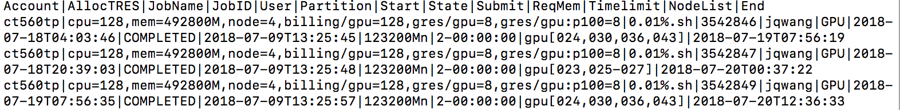
saact & sacctmgr Raw Data
Sample sacct command for GPU nodes:
sacct -a -P -X -S 071918-00:00:00 -E 072018-23:59:59 --format=Account,AllocTRES,JobName,JobID,User,Partition,Start,State,Submit,ReqMem,Timelimit,NodeList,End -s CANCELLED,TIMEOUT,FAILED,COMPLETED,NODE_FAIL,OUT_OF_MEMORY -r GPU,GPU-shared,GPU-small> today_gpu.csv
Sample sacctmgr command:¶
sacctmgr show events -P event=node Start=071918-00:00:00 End=072018-23:59:59 > today_state.csv

Slide 14
Analysis on Resources
GPU Utilization & Backlogs
EX: Run a GPU job on 4 P100 nodes for 30 minutes is
→interact -p GPU --gres=gpu:p100:2 -N 4 –t 30:00:00
RM Utilization & Backlogs
EX: Run in the RM-shared partition using 4 cores and 1 hour of walltime.
→interact -p RM-shared --ntasks-per-node=4 –t 1:00:00
→interact -p RM -N 2 -t 30:00
LM Utilization & Backlogs
EX: Run in the LM partition for 10 hours of wall time and 6TB of memory is:
→interact -p LM - t 10:00:00 --mem 6000GB
Dashboard Link: http://rubber.bridges.psc.edu:5601/

Slide 15

3. Data Pipeline

Slide 16
Calima Dashboard Data Pipeline
CSV files
Raw data
preprocess.py
Processed data
rubber.bridges.psc.edu
automate.sh
Execute command to extract data
Invoke python script to clean data
Copy the processed data to docker (inotifywait package)

Slide 17
Logstash

Slide 18
Elasticsearch under the hood - Lucene

Slide 19
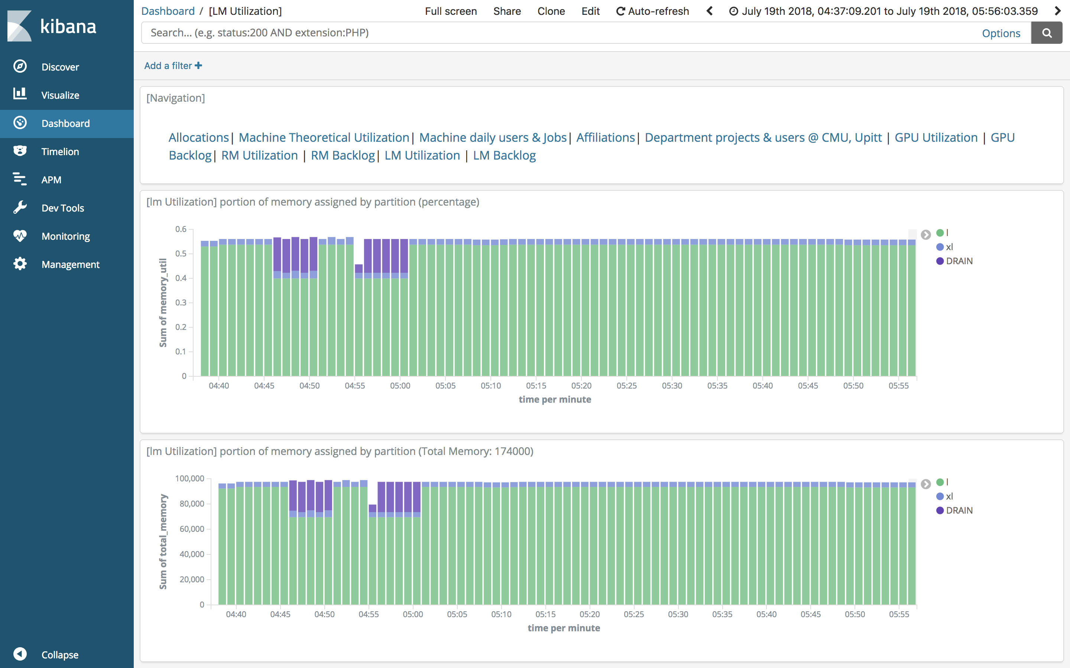
Kibana

Slide 20

4.
Data
Preprocessing

Slide 21
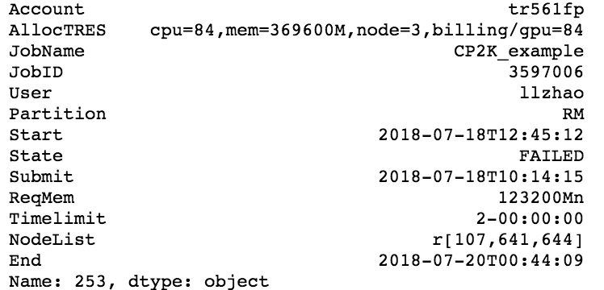
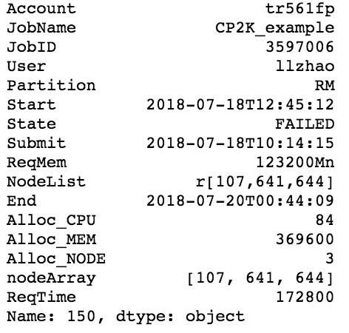
Data Preprocessing (1) – Job Transform
Take RM Node as an example
AllocTRES cpu=32,mem=123200M,node=1,billing/gpu=32,gres/gpu=2,gres/gpu:p100=2
NodeList r[ 107, 108-110, 131, 565]
NodeList l[ 003, 004-005, 009],xl[ 001, 002]

Slide 22
Data Preprocessing (2) - Time
(submit) (start)
Transform start and end time to minute per row (like taking snapshot)
If a job has a start time of 2018-07-19T13:28:35 and end time of 2018-07-19T13:32:21 in sacct, this single job will be converted to four rows with timestamp like the following:
2018-07-19T13:28:35
2018-07-19T13:32:21
2018-07-19
13:28:00
2018-07-19
13:29:00
2018-07-19
13:30:00
2018-07-19
13:31:00
2018-07-19
13:32:00
2018-07-19
13:33:00
***A job that waits for 10 days to be executed would have 60*24*10= 14400 rows

Slide 23
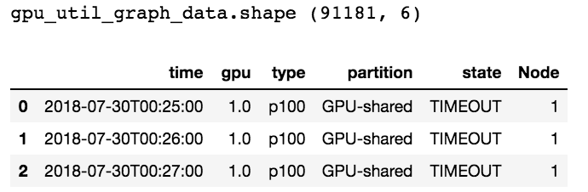
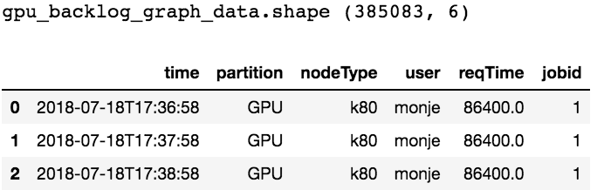
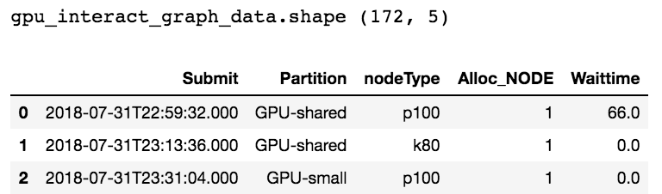
Preprocessed Data (August 1st –August 3rd )
GPU
Utilization
Backlog
Original
(2374, 18)
Interactive

Slide 24
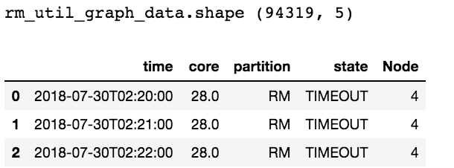
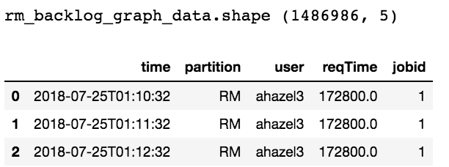
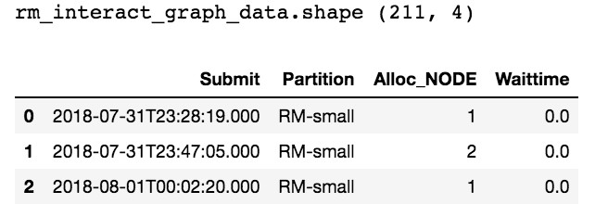
Preprocessed Data (August 1st –August 3rd )
RM
Utilization
Backlog
Original
(8306, 18)
Interactive

Slide 25
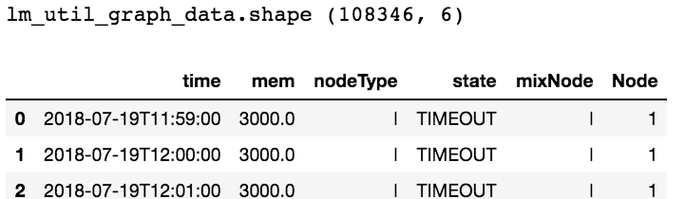
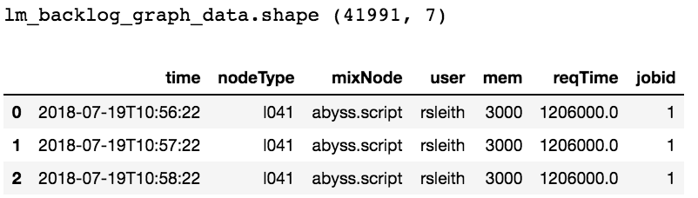
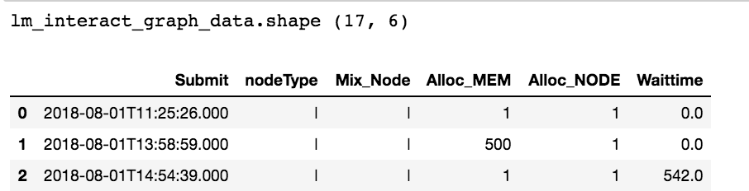
Preprocessed Data (August 1st –August 3rd )
LM
Utilization
Backlog
Original
(4170, 18)
Interactive

Slide 26
5. Dashboard Demo

Slide 27

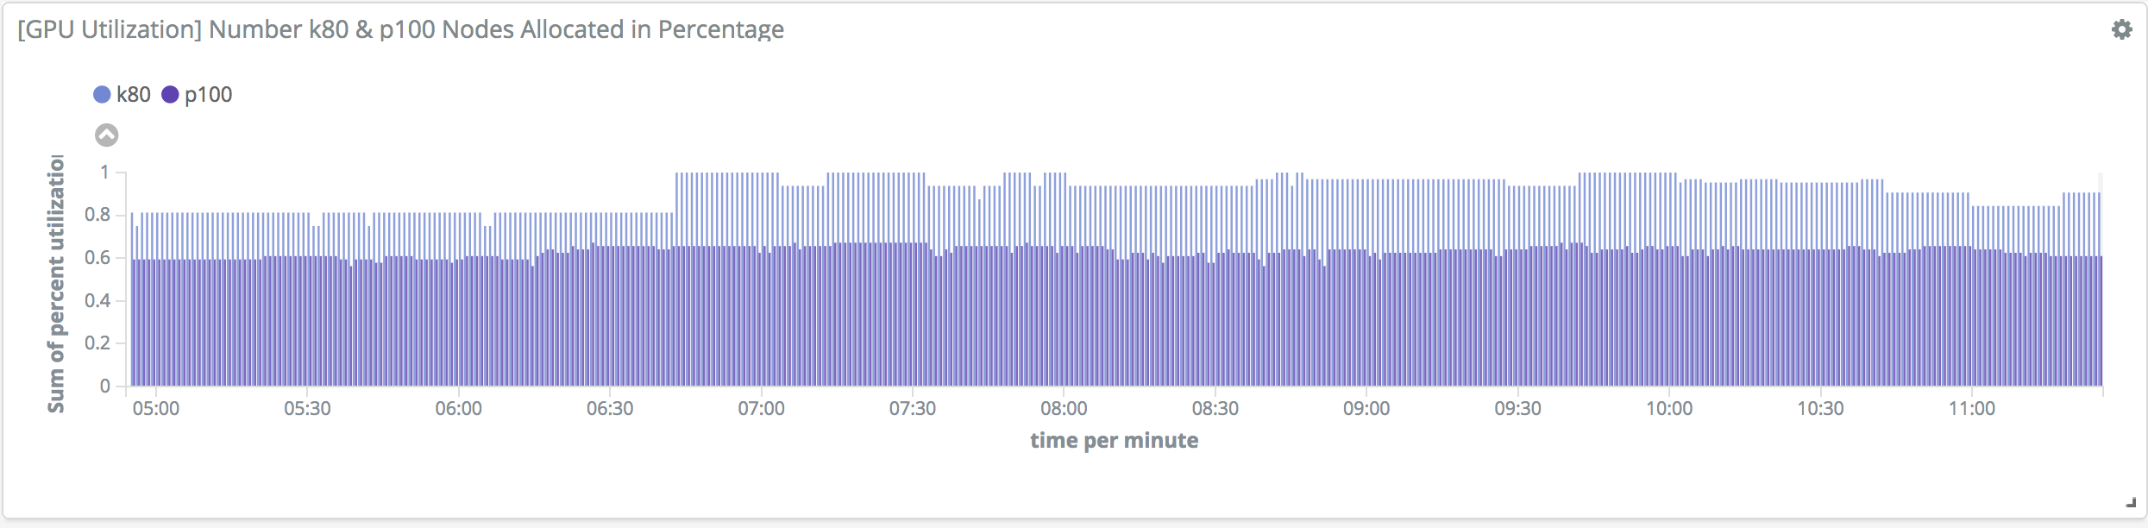
GPU Utilization

Slide 28
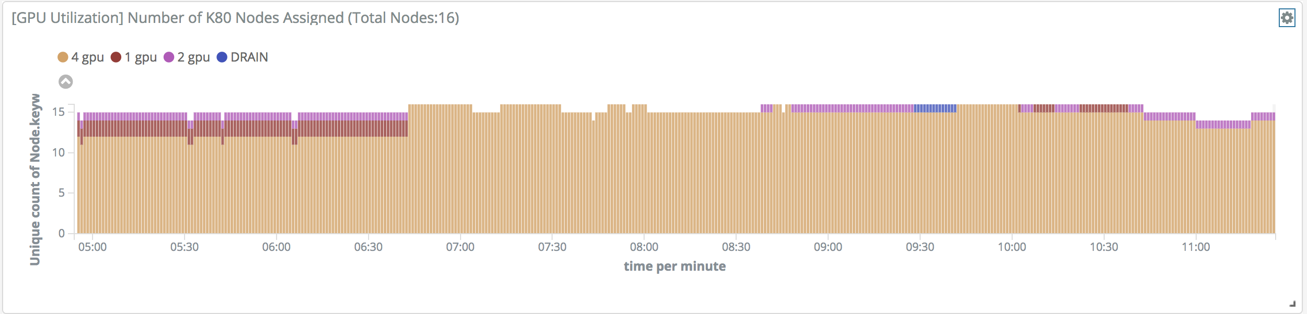
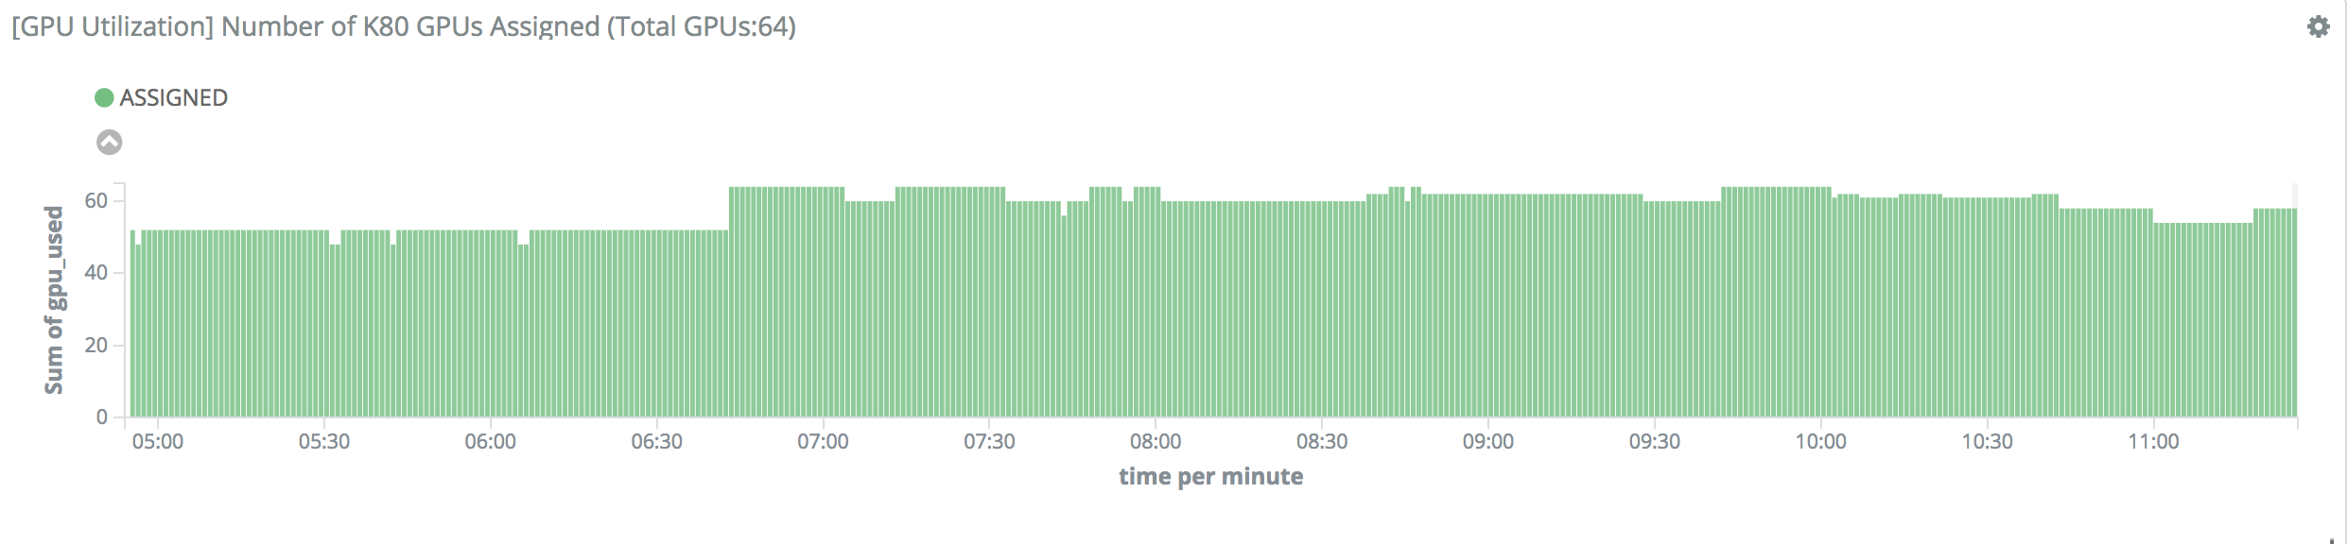
GPU Utilization

Slide 29
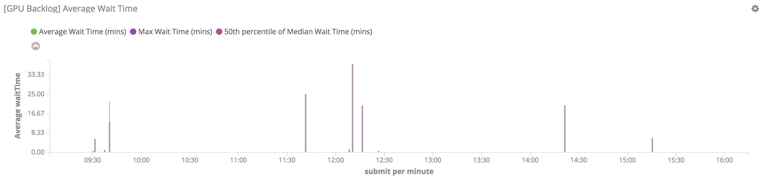
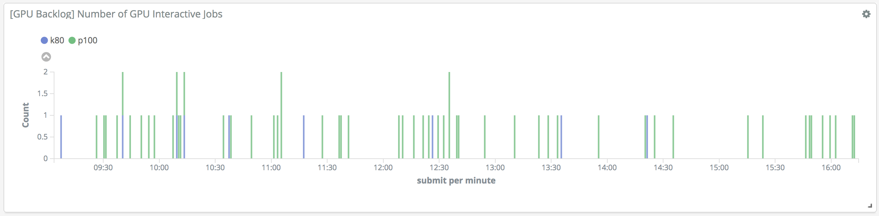
GPU Backlog

Slide 30
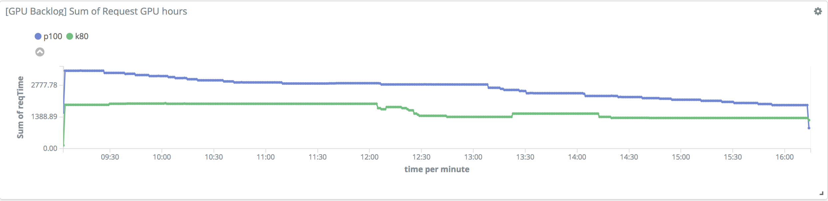
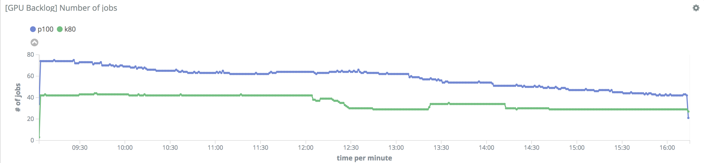
GPU Backlog

Slide 31
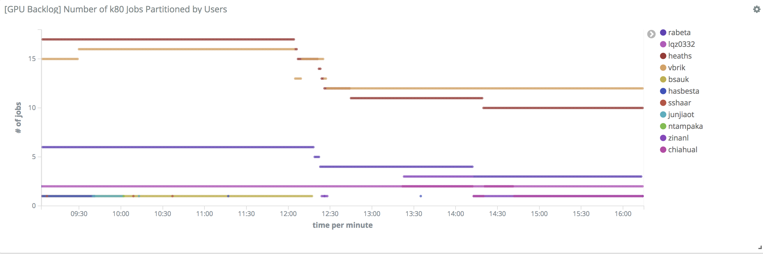
GPU Backlog

Slide 32

6. Project Benefits for PSC

Slide 33

Quotations are commonly printed as a means of inspiration and to invoke philosophical thoughts from the reader.

Slide 34
Thanks!
any
questions
?
You can find me at
chiahual@andrew.cmu.edu

